Slide 1
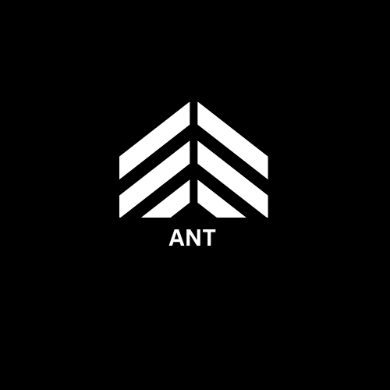

ANT MEDIA
Grow yours

Slide 2
SERVICES we provide-
Business promotion specialist
Social media management.
Lead generation.

Slide 3
Treatment specialisation that you have-
Stroke and paralysis.
Severe spinal cord injuries.
Traumatic Brain injuries.
Autism for children.

Slide 4
How we will help you!
Save time.
Save money.
Increase your social presence.
Build your brand.

Slide 5
The one who are getting the most amount of leads are present in the industry–
Leverage social media
Create Awareness
Building Brand self image

Slide 6
Competitor Analysis

Slide 7
Clinic’s
Target audience
FB account?
Insta Account
Leads thru social media
1
Neurolink physiotherapy
6 to 8
159 follow
19.1k
follow
2
Dr Maan Physiotherapy
9 to 12
151
follow
Yes
3
HCAH care India
12 to 6
279k follow
971
follow
Yes
4
India physios
3 to 6
600 follow
7.4k
follow
5
IBS rehab physiotherapy
9 to 12
7.7k
follow
123
follow
Yes
6
KRV Physiotherapy
center
9 to 9
5.6k follow
3k
follow
Yes

